Slide 1
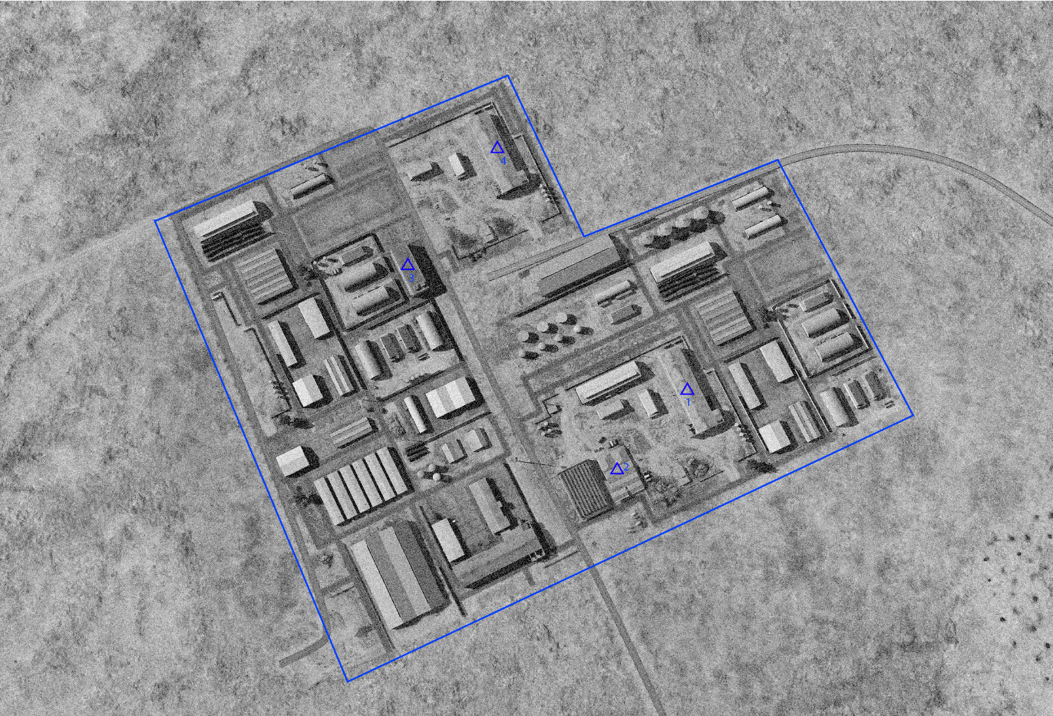
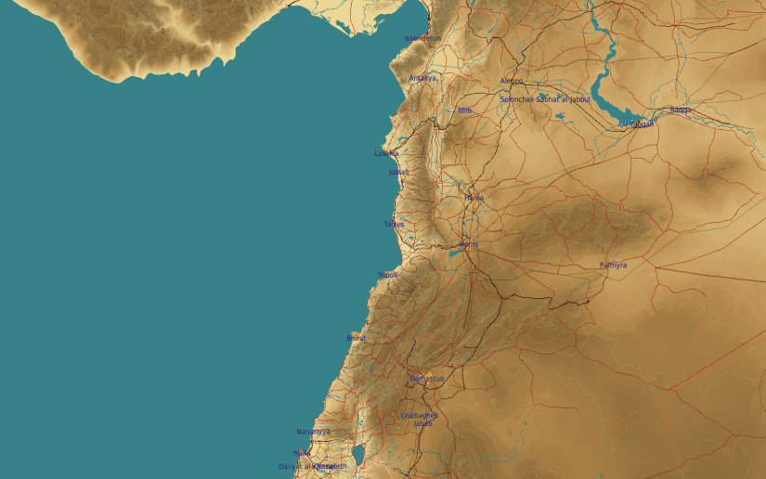
OPARTGT024 AL DUMAYR VEHICLE FACTORY
N
24
DESIRED POINT of IMPACT:
DPI 4 - N33 48.190 E 36 41.050 / 2727ft / 2000lb Bomb
DPI 3 - N33 48.108 E 36 40.998 / 2738ft / 2000lb Bomb
DPI 2 - N33 47.982 E 36 41.142 / 2734ft / 2000lb Bomb
DPI 1 - N33 47.036 E 36 41.194 / 2731ft / 2000lb Bomb
No CDC concerns.

